Slide 1

Bachelor Of Technology
Computer Science and Engineering (Data Science)
311 Program in collaboration with Virginia Tech. USA
Mini-Project Presentation
SVKM’s NMIMS
Mukesh Patel School of Technology Management and Engineering, JVPD, Vile Parle, West
Mumbai- 400056

Slide 2

A PRESENTATION ON
“TRANSPORTATION MODEL FOR UBER & LYFT” (Price Optimization Model for Uber & Lyft based on Demand & Supply)
By
PARTHVI JOSHI-L024
ARYAN KULKARNI-L027
KRISH MANIAR-L033
HARSH MEHTA-L034
Faculty Mentors:
Prof. Ami Munshi, Prof. Mahesh Mali and Prof. Khinal Parmar

Slide 3
Contents.
Introduction
Literature Survey
Problem Statement
System Description
Implementation
Result and Analysis
Conclusion
Future Scope
References

Slide 4

Introduction.
Sometimes it is just convenient to leave the driving to someone else. This is just less stress, more mind space and one gets to use that time to do other things. Well, that is one of the ideas that grew and later became the concept behind Uber and Lyft.

Slide 5
.
In this presentation we’ve done the analysis of Uber and Lyft rides with a variety of data using the TRANSPORTATION MODEL to calculate the minimization of cost .
Objective: The goal of a transportation model is to determine the schedule for transportation from source to destination in such a way that travelling costs are minimized while all demand and supply constraints are met

Slide 6
Problem Statement.
To calculate the optimal solution(minimization of cost) of Transportation Simplex Model using Python between six sources and destinations based on the supply and demand given.
General analysis of comparison between various parameters given in the dataset.

Slide 7


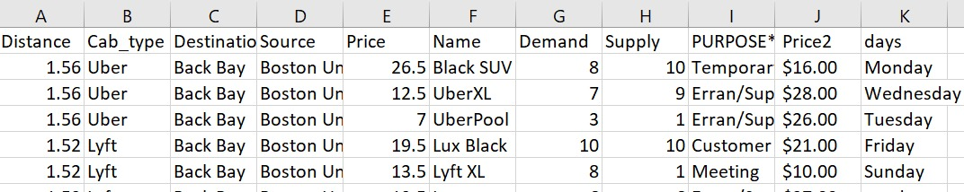
System Description.
Hardware & Software Requirements
1)Python 3.0 should be accessible.
2)Access to SAS Visual Analytics is required.
3)Has use of MS Excel and Kaggle.com for dataset

Slide 8
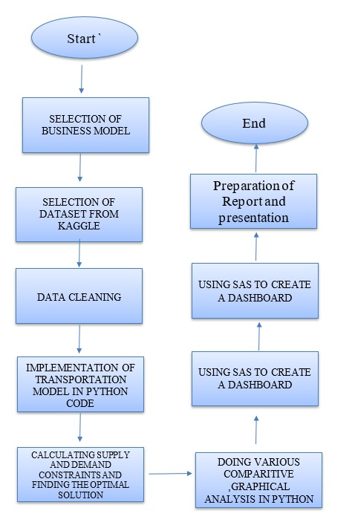
FLOW CHART.
Figure 1 Flow chart.

Slide 9
Implementation.
We imported some libraries of pandas and pulp. (Pulp:- Lpproblem, LpMinimize ….)
Calculated demands for 6 different destinations and 6 different sources and we noticed that demand>supply, so we added dummy destination.
We created a linear optimization problem, generated an index list for decision variable x and created a model to solve the program.
Form the LP objective function and that are subjected to demand constraints and supply constraints.
Then we use inbuilt function model.solve() to solve the LP problem.
And at last we print the minimum cost that will be incurred to the
cab company for satisfying all demand and supply.

Slide 10
Result and Analysis.
The solution obtained is of utmost importance in our day to day lives since it helps us obtain the most cost effective choice between Uber and Lyft of sources and destinations at various distances.
It helps us analyze the demand for various types of cars used to travel which could be used for companies during production.
This assists the company in locating their outlets as well as the availability of cabs in various locations.
It also helps the companies to decide their most profitable route and analyze at which location they are falling short of vehicles.

Slide 11
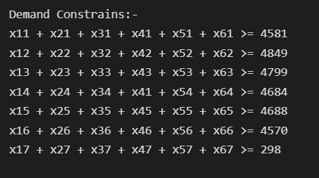
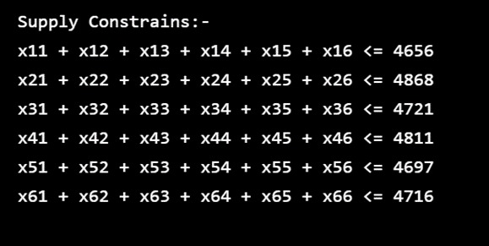
Result and Analysis.

Slide 12
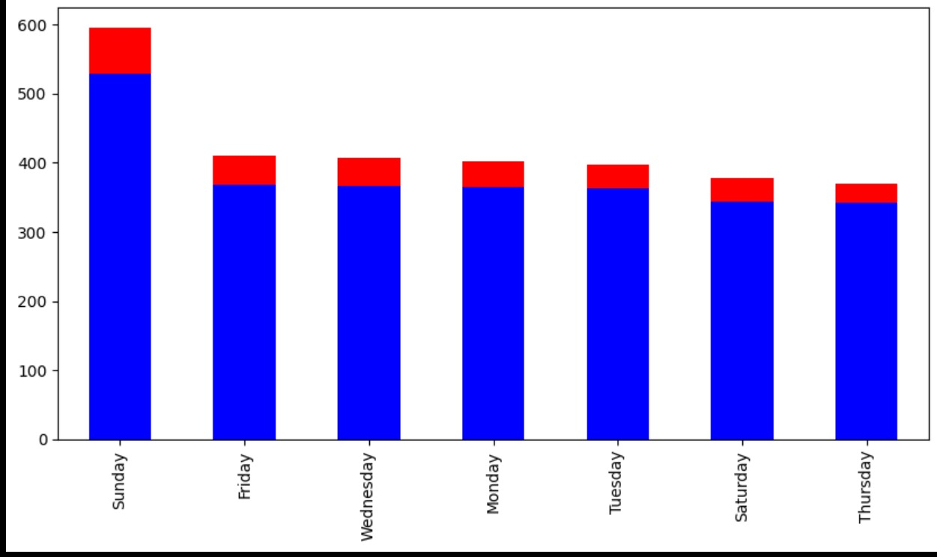
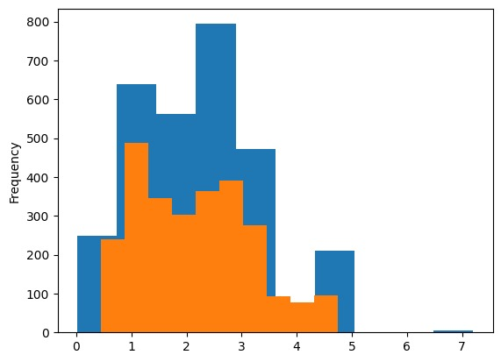
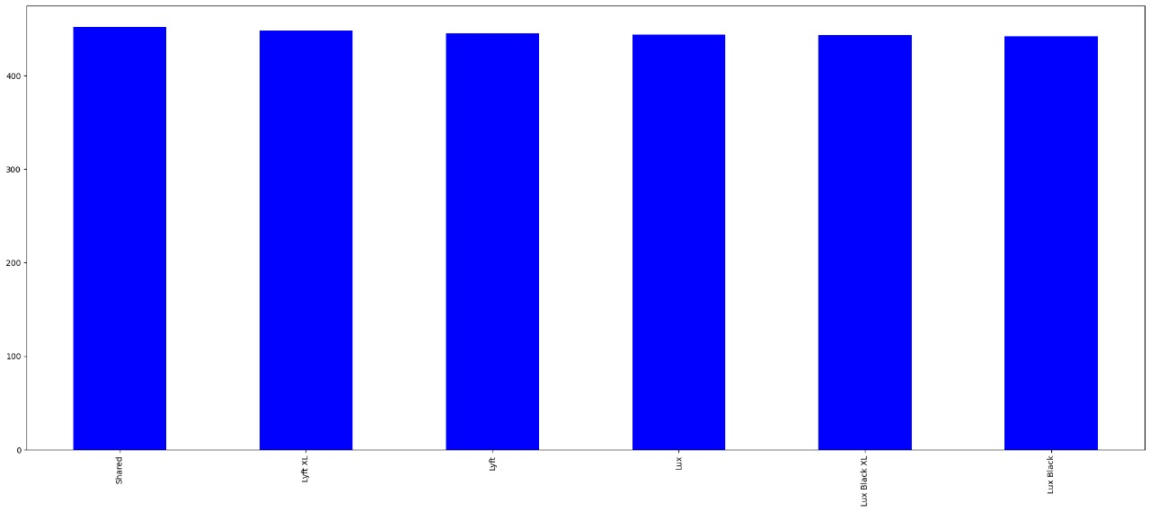
Result and Analysis.

Slide 13
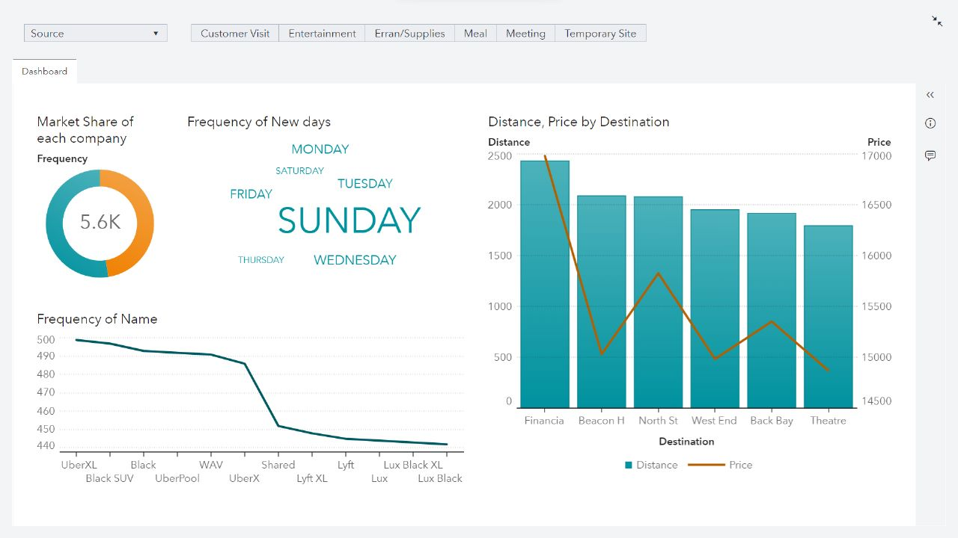
Result and Analysis.

Slide 14
References
Dataset link- https://www.kaggle.com/datasets/ravi72munde/uber-lyft-cab-prices
https://www.projectpro.io/article/uber-data-analysis-project-using-machine-learning-in-python/589#:~:text=all%20New%20Projects-,The%20Uber%20Datasets,Uber%20users%20in%20two%20cities

Slide 15
THANK YOU

